Slide 1
Architecture in China
Where do you start with China? The variety and diverse architecture from modern to traditional is truly amazing.

Slide 2
Architecture in China: weblinks
http://www.britannica.com/EBchecked/topic/719162/Chinese-architecture: a very good place to start, with authoritative and quite detailed overview.
http://www.archaeolink.com/traditional_chinese_architecture.htm has more resources -- lots of good links.
Specifically for younger children:
http://www.historyforkids.org/learn/china/architecture/
http://architecture.pppst.com/chinese.html

Slide 3
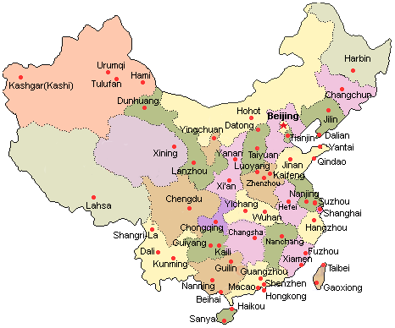
Use a map to locate the following in China: Beijing, Shanghai, Xi’an, Hong Kong and Gobi Desert. There are special houses of the Hakka tribe or houses along the canals of Suzhou (the “Venice” of China”).

Slide 4
Here are some examples of interesting architecture of Hakka and Suzhou houses

Slide 5
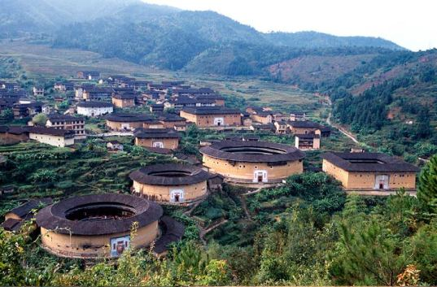
Hakka Houses – first thought to be military silos!

Slide 6
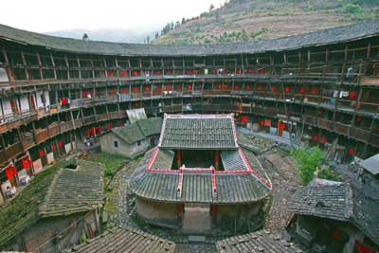

Slide 7
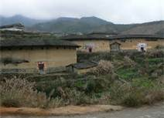

Slide 8
Some things to consider with regards to architecture in China:

Slide 9
How would you expect the climate to differ in North and South China? How does this affect the way houses are built?

Slide 10
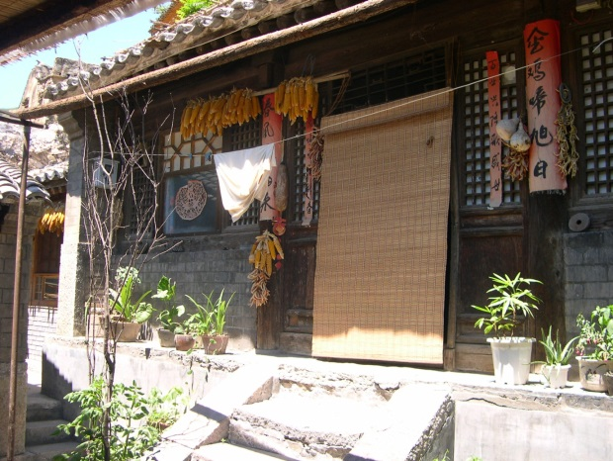
Housing in the North of China The photograph below shows a traditional house from Northern China. This kind of house is called a “One Bright, Two Dark” house.

Slide 11
The house is in the shape of a rectangle and always has three rooms in a line. It always faces south – the south wall being the front of the house and this is also where the door is to enter the house.
The main room is the bright room. The bright room opens to the south and is usually the largest room.
The floor also might be raised. One reason why this room might be very important is because it contains the ancestral shrine. This is where we the family worship the family ancestor. You can see the shrine as soon as you enter the room.

Slide 12
The room also has one or two cooking stoves. However, these are not only where the family cook. They are also an important source of heat in the winter.
Farm equipment which the farmers cannot keep outside are also stored in this room.

Slide 13
On either side of the “bright room” there are two “dark rooms”. Both of these rooms have small latticed windows on the south wall and contain a “kang”. The kang is a platform made out of bricks. In the cold winter, warm air is carried from the stove in the bright room to the centre of the kang by a system of pipes. The warm air rises through the kang and it becomes the centre for family life – just as a fire place might do in Scotland. At night, people can sleep on the kang and during the day they sit there working, preparing food, sewing or just talking.

Slide 14
The “dark room” in the West is the less important dark room. The younger generation – a son and his family – will live here. It is quieter during the day. The family will keep grain here.

Slide 15
From the outside, the house is quite bare. It will often be made out of earth or if the family is richer, out of bricks. There may be some colourful decoration around the windows and doors.
There may be a yard in front of the door to the South. This may contain a toilet, a well, a storage shed for wood and straw and pens for raising chickens, ducks or a pig.

Slide 16
Task:
The “two dark, one bright” home is an energy efficient home.
How can we heat our houses efficiently in Scotland? Investigate ways of making our homes and schools more energy efficient using the Internet.
Why do you think Chinese people like to have mountains or trees to the north of the house?

Slide 17
The Eaves of the House and the Sun
Houses in China have adapted to the angle of the sun. The position of the sun varies according to the season. The sun is low in the winter and high in the summer. This means that sunlight approaches the house at different angles in winter and summer.

Slide 18
The Eaves of the House and the Sun
In winter the angle is low. Sunlight travels under the eaves and throughout the walls to heat up the interior.
In summer the angle is high. As a result the eaves shelter the house from the sun and the interior stays cool. Thus, traditional Chinese housing has adapted to the environment.

Slide 19
Houses in the North – Courtyard Houses
These are the most well- known traditional type of houses in Northern China. They are “Siheyuan” or courtyard houses.

Slide 20
At the centre is a spacious courtyard.
The arrangement of paths, trees , buildings is symmetrical.
The main gate is very simple, opening into a small courtyard.
This hides the size of house and provides privacy.

Slide 21
The older generation live in the buildings at the very back of the house - facing south. This is the most important building.
An older married son will live in the East of the building with his family. A younger married son will live in the west building with his family.

Slide 22
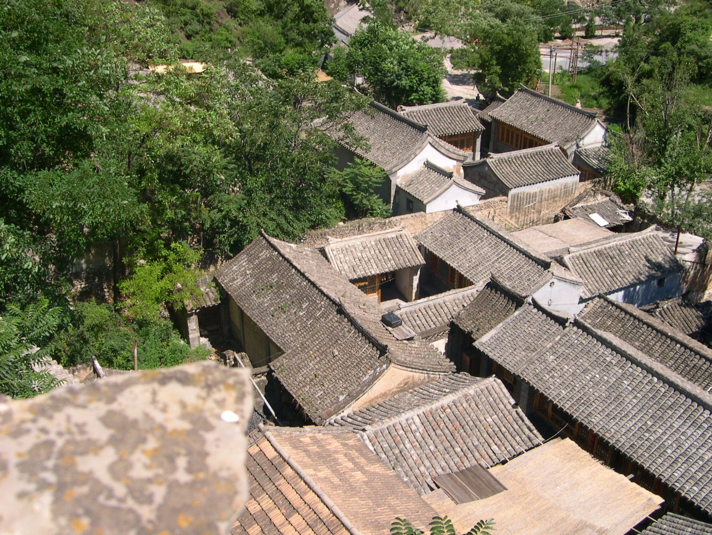
A veranda goes around the perimeter of the courtyard. This provides shelter and shade.

Slide 23
Houses in the South
The climate in the South of China is often hot and humid. For example, Chongqing which is a city of 33 million (the biggest city in China and growing!) is known as “The Oven” as it is so hot and humid in the summer.

Slide 24
Houses in the South
Some of the features of the houses in the South are:
The walls are made of white plaster to help reflect the sunlight, keeping the temperature down.
A steep roof helps rain water flow quickly off the roof
The houses are often two-storeyed which allows more people to live in a single house – the population density is much higher in the South of China.

Slide 25
Houses in the South
Some of the features of the houses in the South are:
Overhanging eaves keeps out unnecessary sunlight and avoids ground radiation (sunlight which has reflected off the ground.)
Detached kitchens keep the heat from the kitchens outside the house.
Small high windows reduce the amount of sunlight into the house maintain a cool air, allowing daylight and also providing ventilation

Slide 26
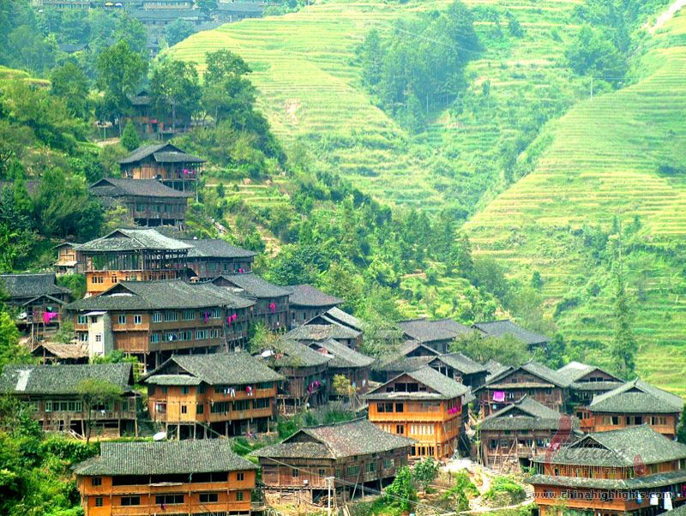

Slide 27
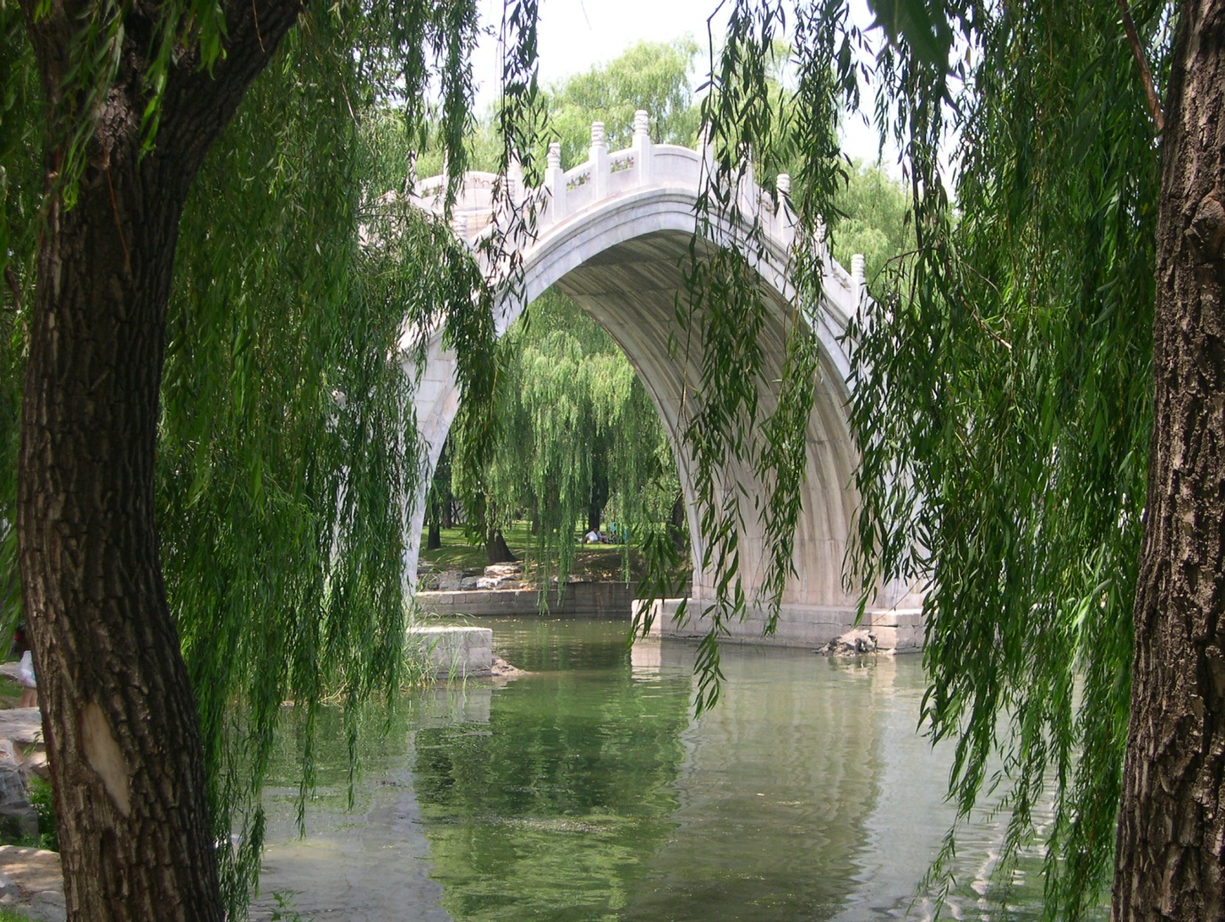
Summer Palace, Beijing
This is a large garden full of beautiful Chinese architecture such as these bridges with their balustrades which all had a meaning. Willow trees are also significant in the whole effect of architecture in China.

Slide 28
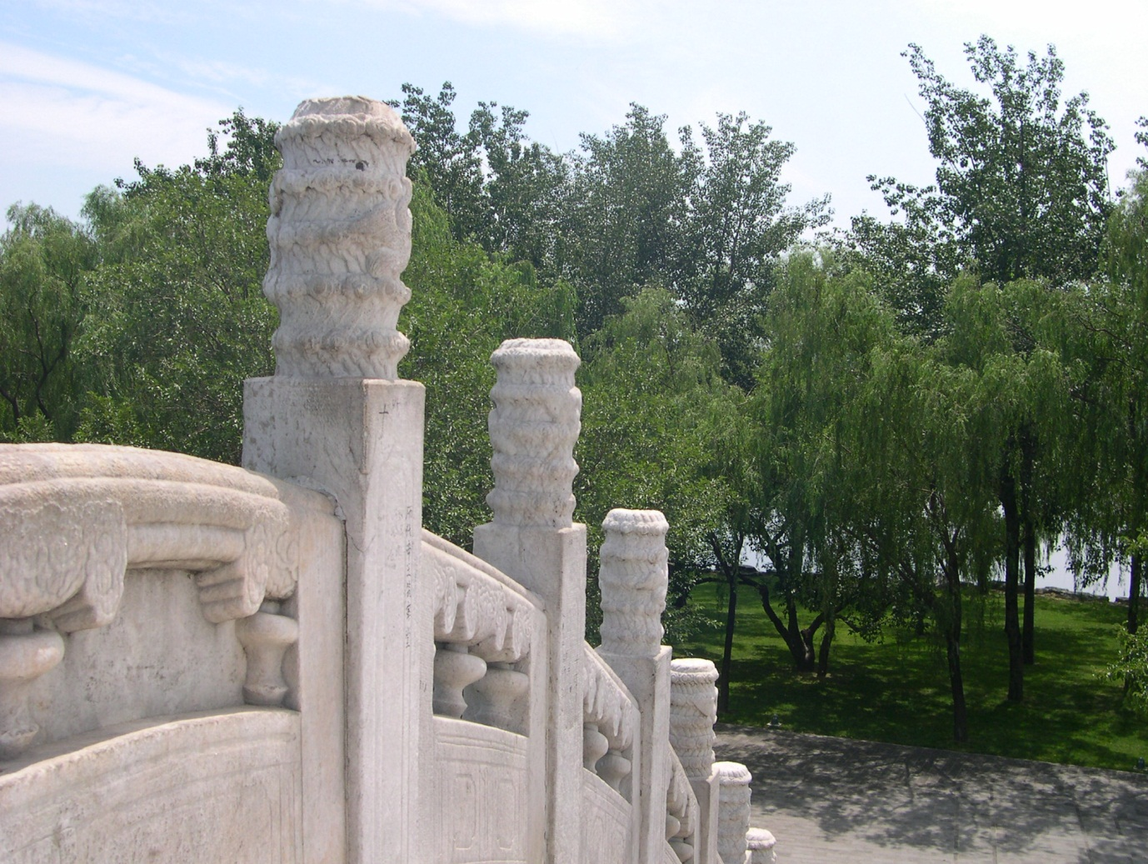

Slide 29
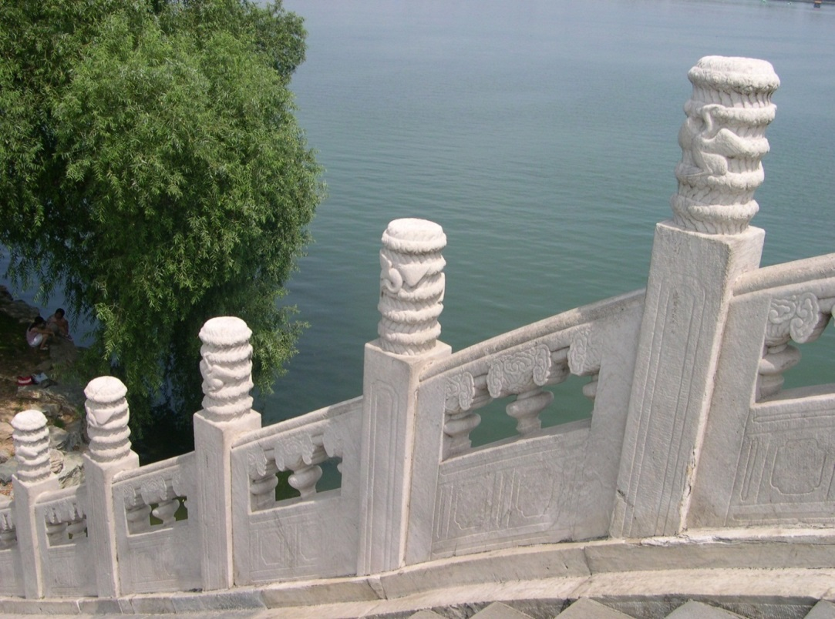
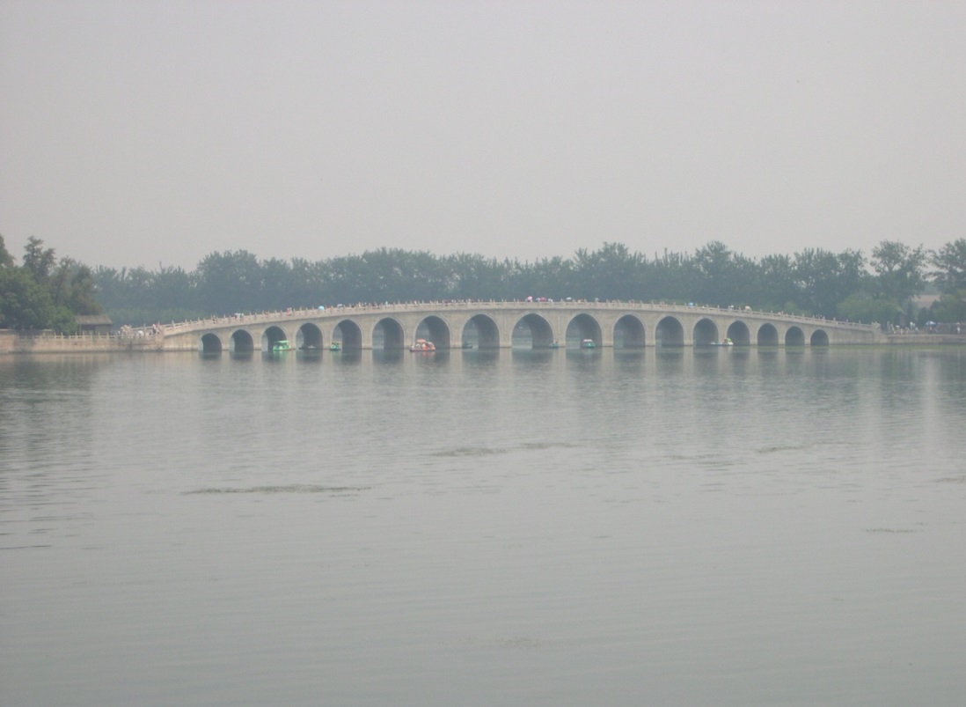
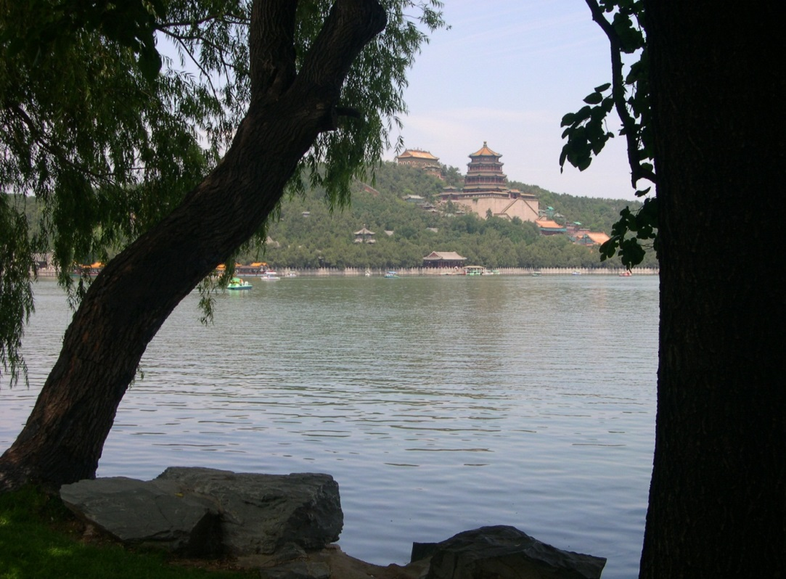
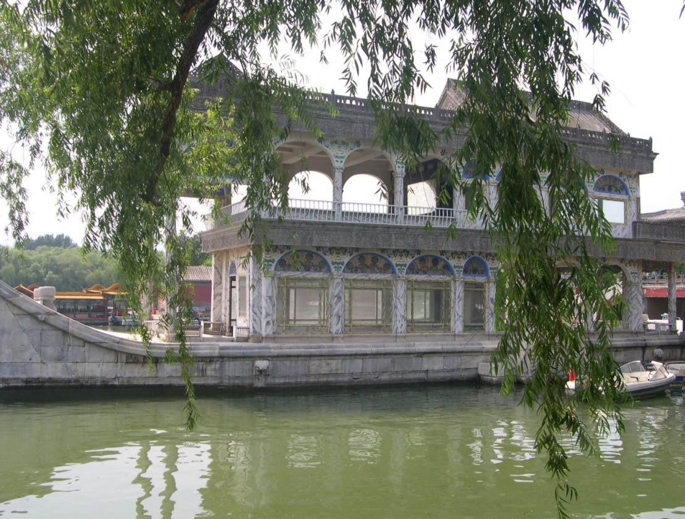

Slide 30
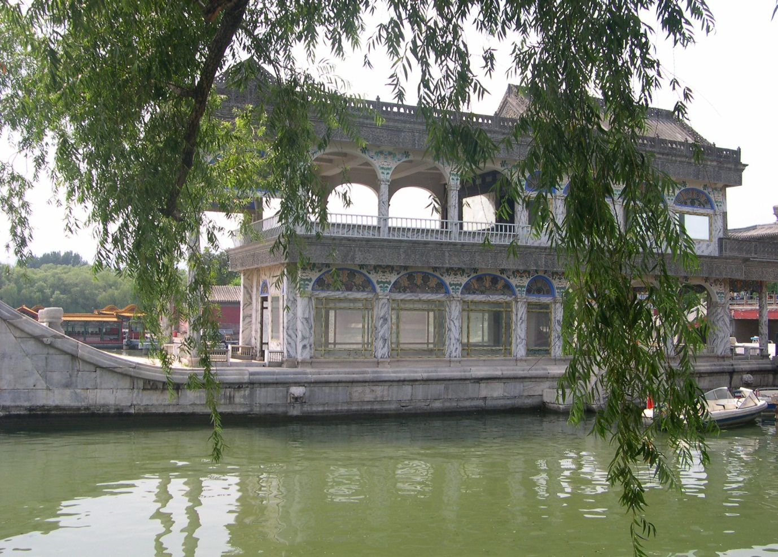
The Marble Boat in the Summer Palace which is moored in Kunming Lake, built for the Empress on her death by the Emperor. (This is rather like the Taj Mahal which was built on the death of the Raj’s wife).

Slide 31
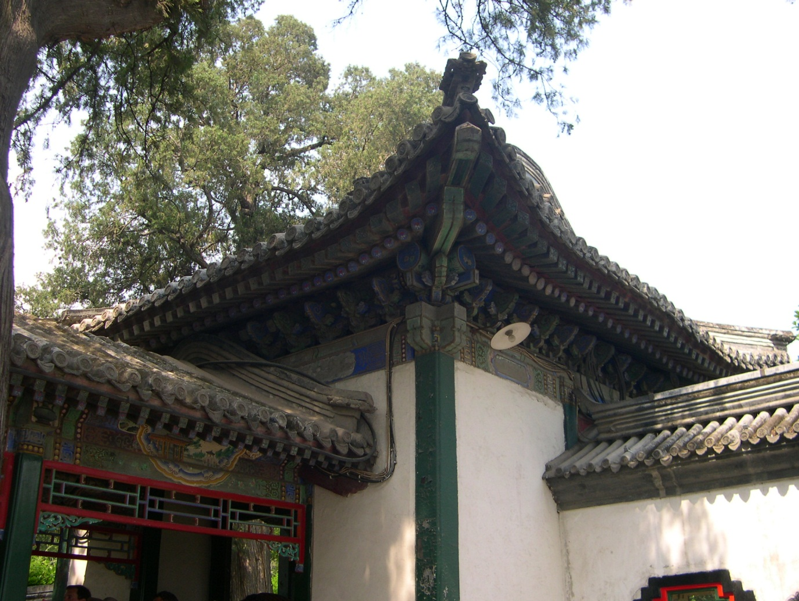
Example of round tiles and roofs in the Summer Palace

Slide 32
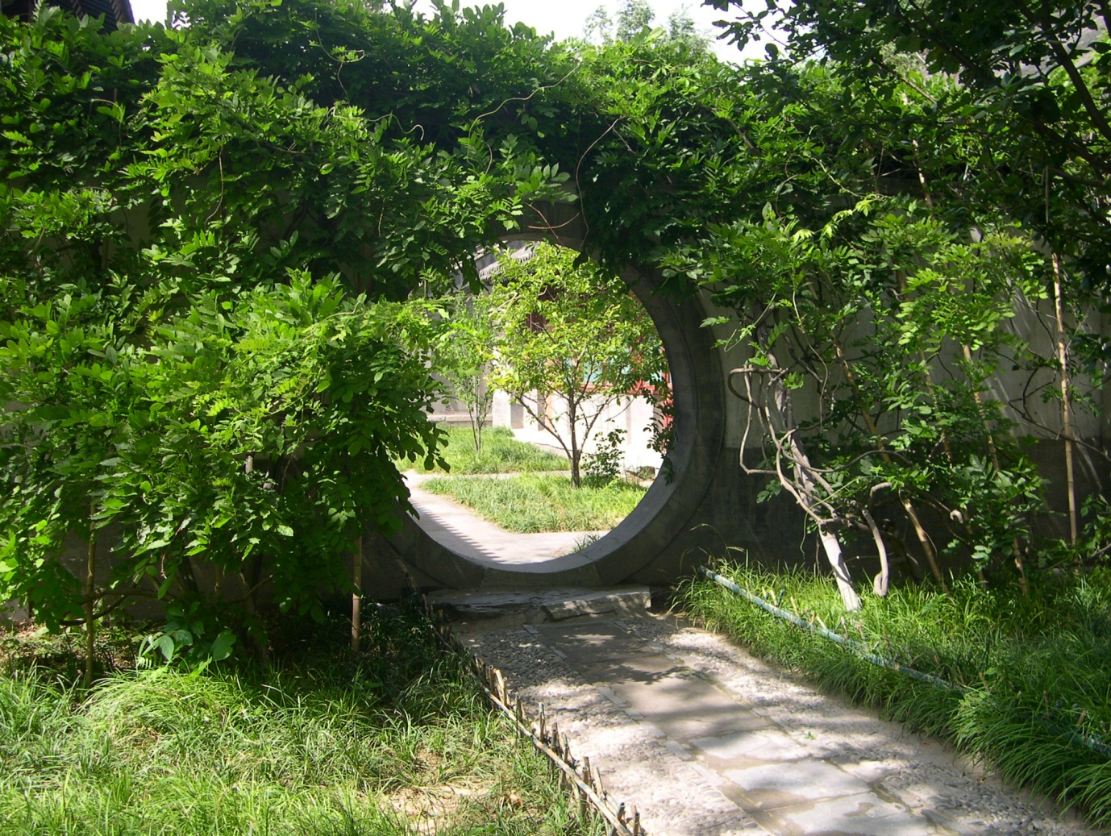
Eternity is symbolised by the circle used as a doorway in Buddhist temples or also in gardens e.g. in the Summer Palace.

Slide 33
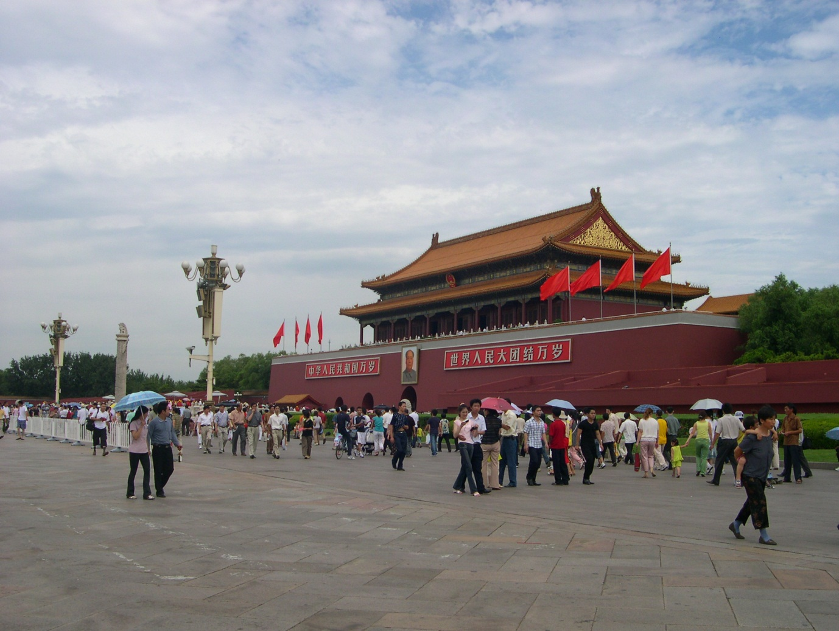
The largest palace on earth – is 2 kms long and contains 9999 rooms.

Slide 34
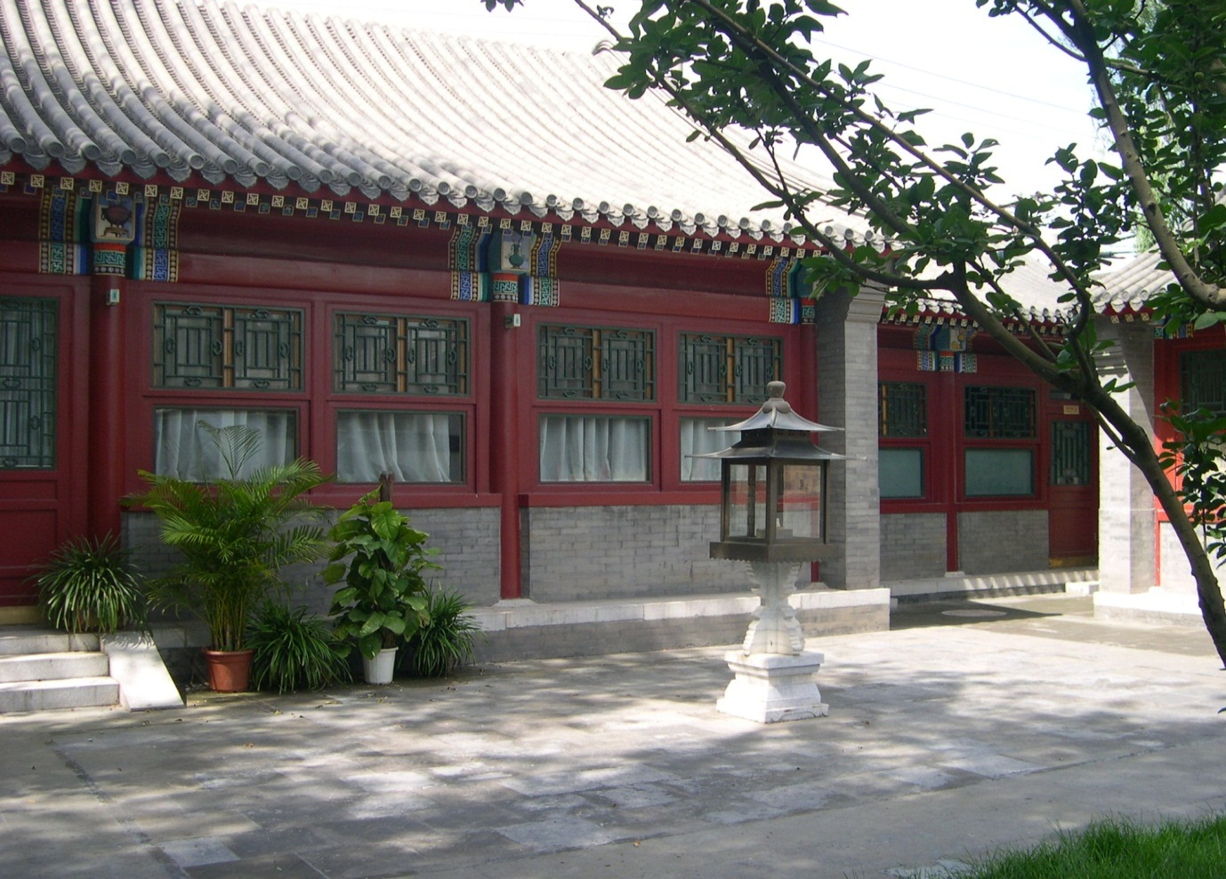
Courtyard inside Forbidden Palace

Slide 35
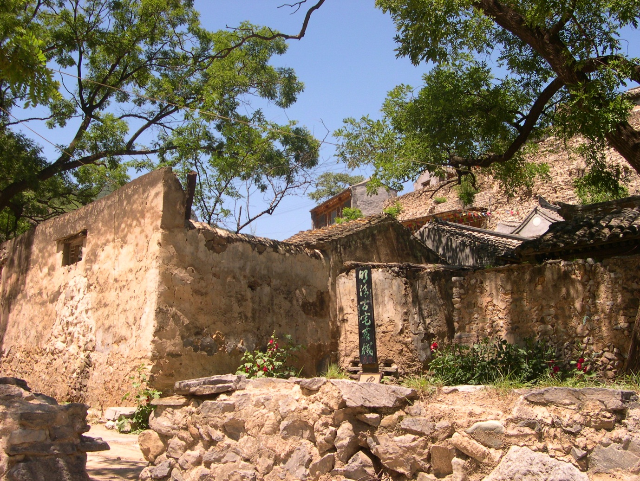
Village just outside Beijing

Slide 36
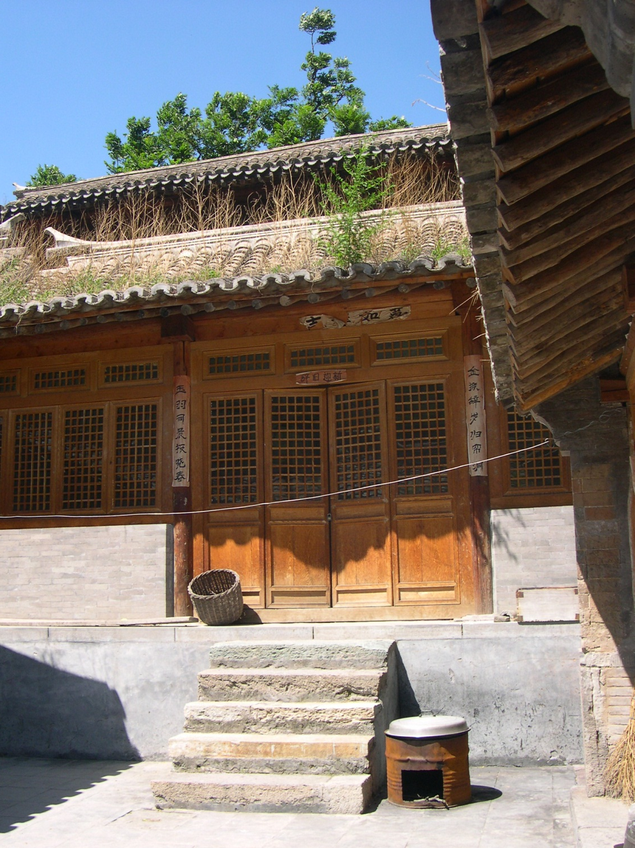
One bright, two dark houses

Slide 37
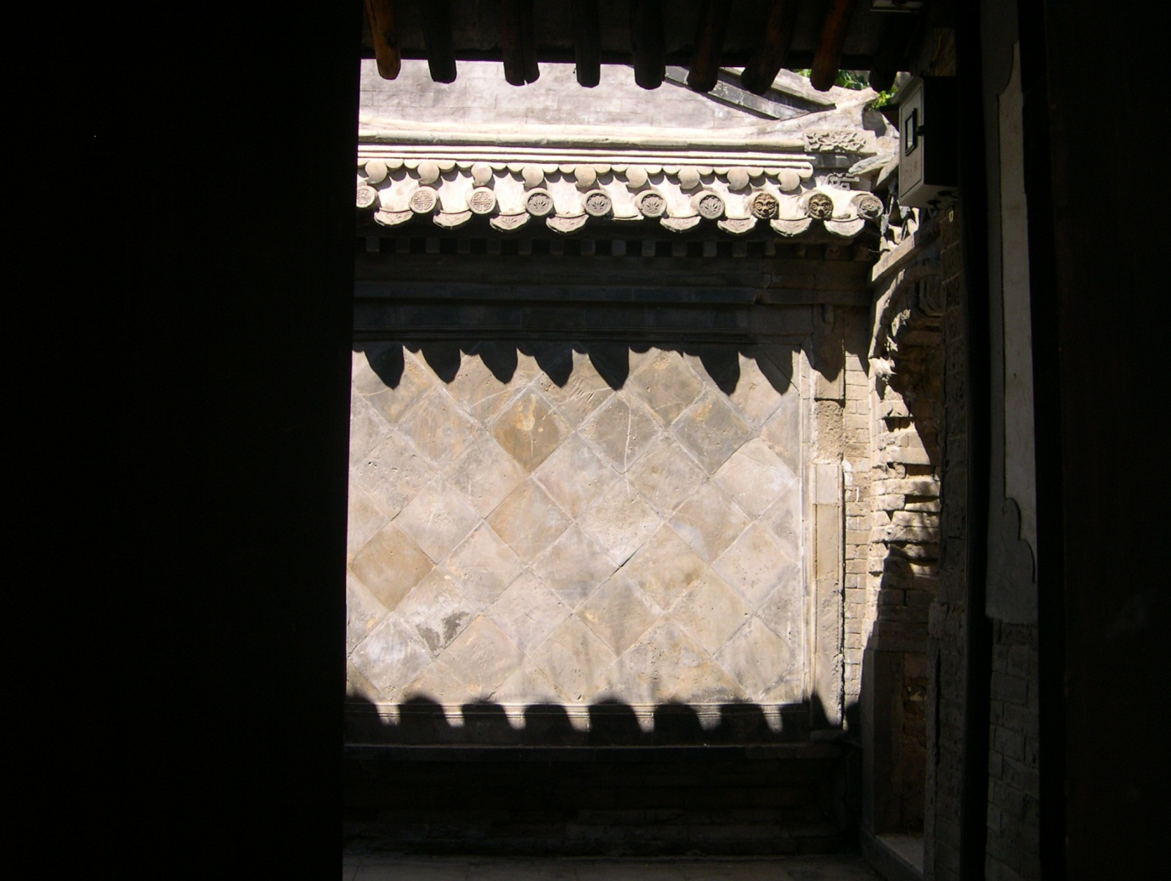
Unique roof tiles – round ends are with embellished

Slide 38
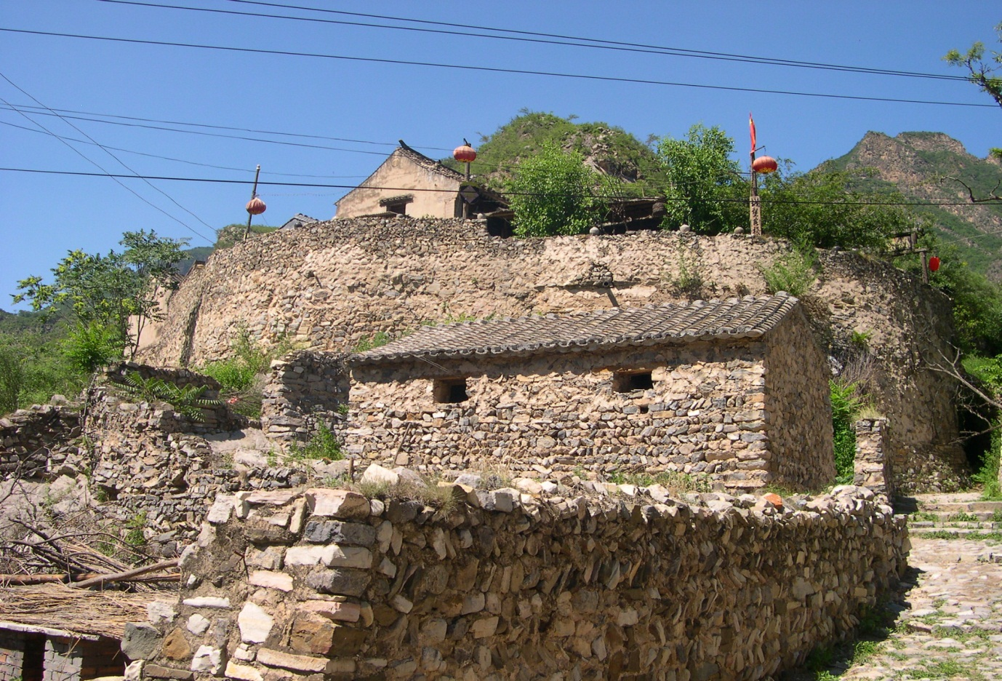
Village toilet block

Slide 39
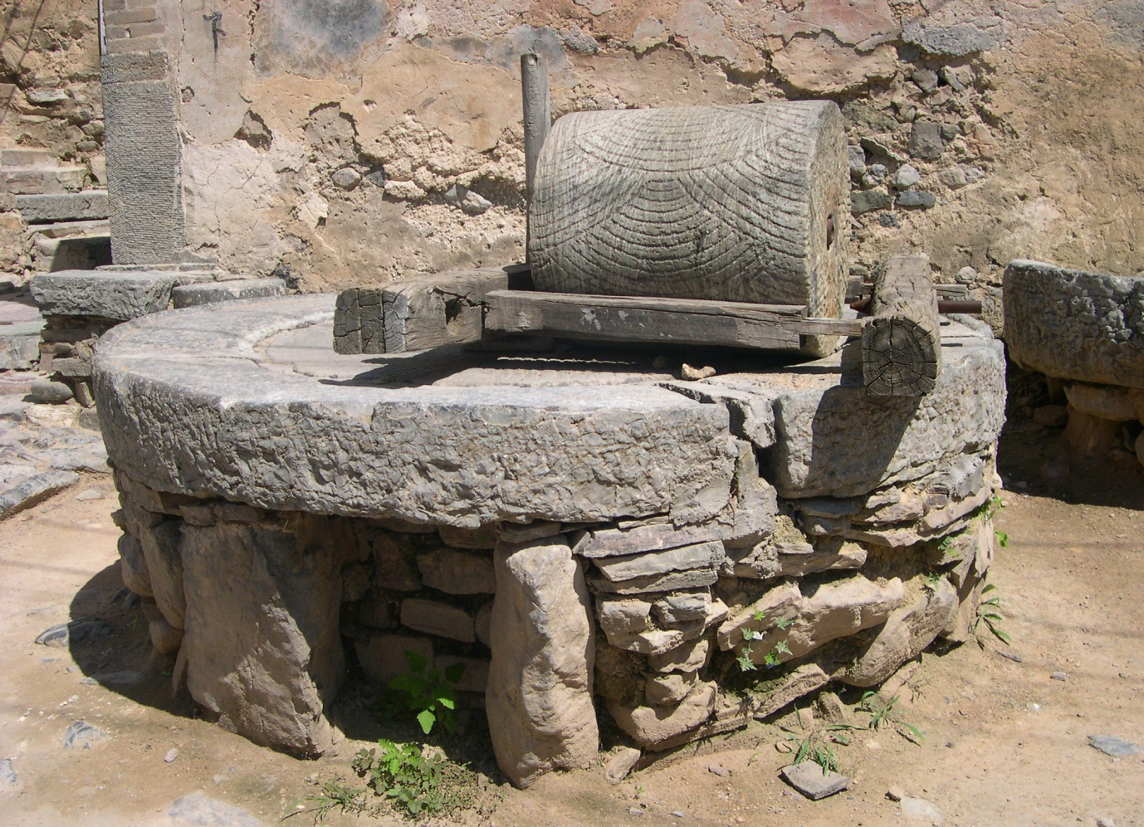
Village Millstone for grinding grain, in North of China near Beijing

Slide 40
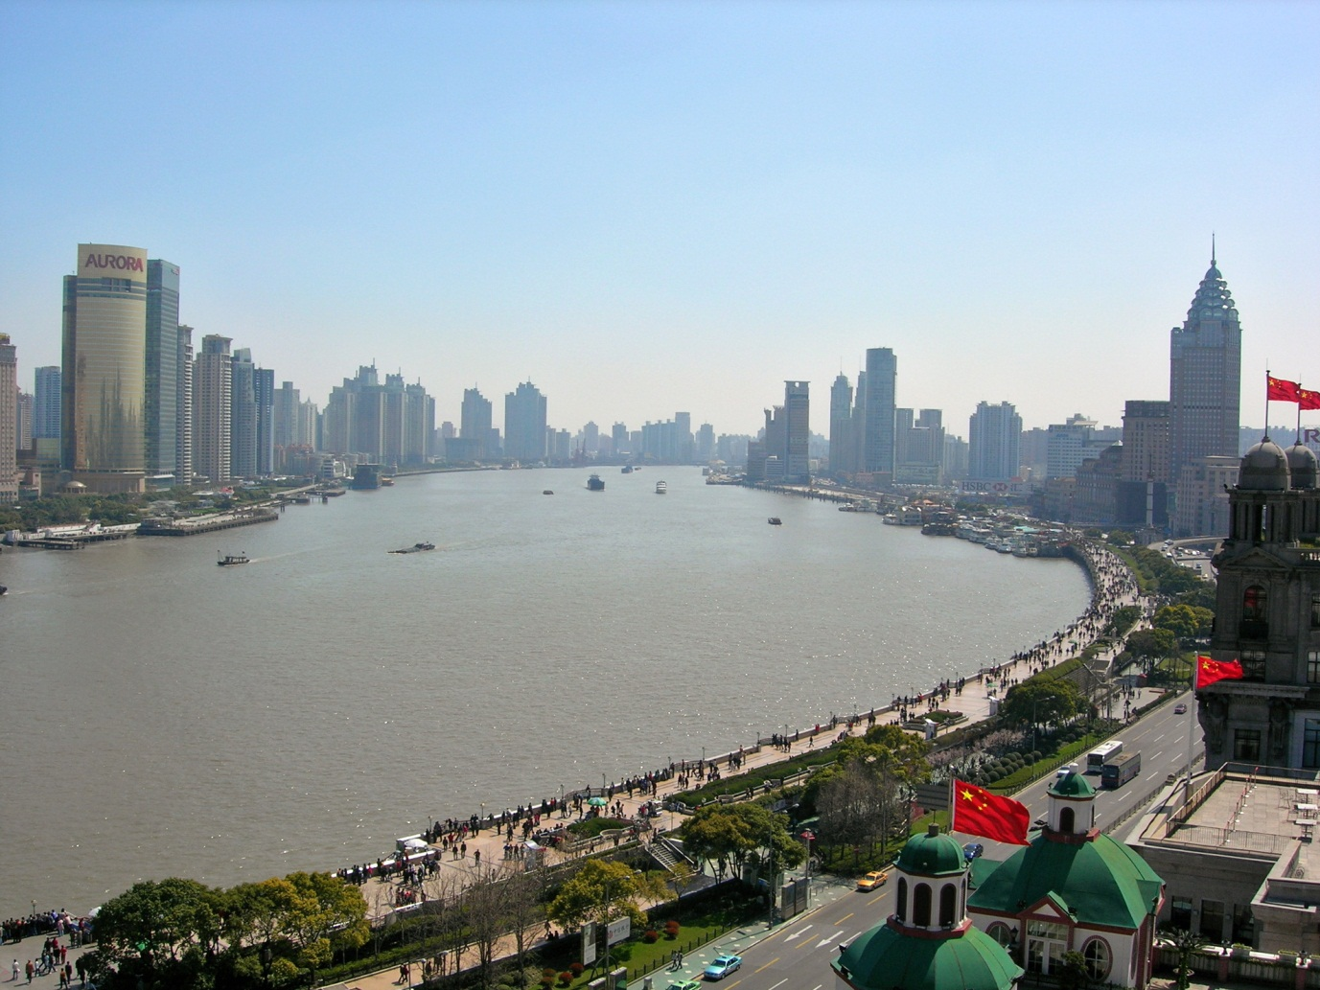
“The Bund” with the famous Pudong area on the left-hand side above

Slide 41
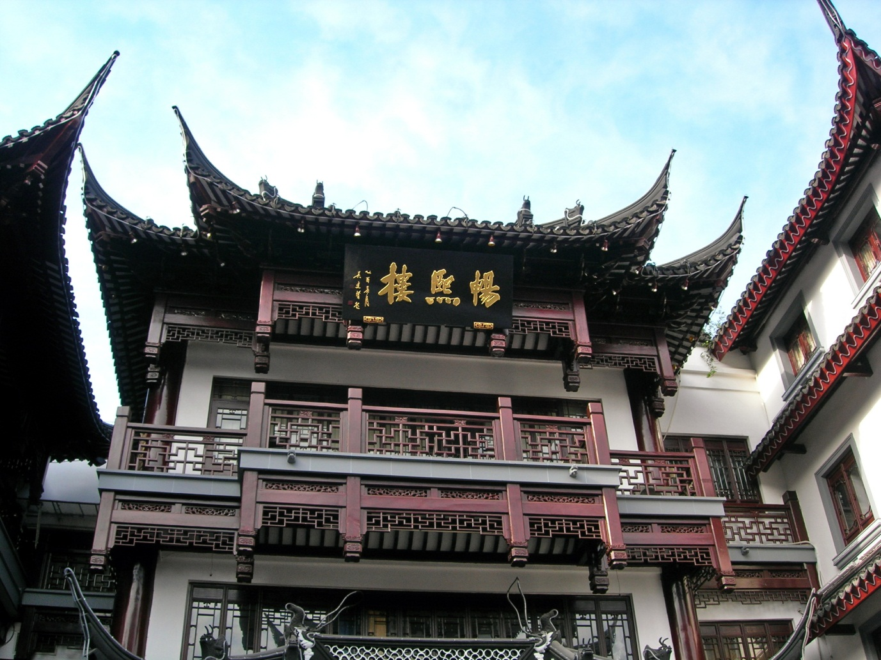
Traditional tea house in Shanghai

